Slide 1
Properties of Functions and Fuzzy Set
Session 11-12
Course : MATH6182 – Discrete Mathematics
Effective Period : September 2021

Slide 2

These slides have been adapted from :
Susanna S.Epp, “ Discrete Mathematics with Applications”, 5th edition,2020, Cengage, Boston, USA, ISBN 9781337694193
Chapter 7
Acknowledgement

Slide 3

Learning Objectives
On successful completion of this Course, students will be able to:
LO 3
Explain set theory, properties of function, fuzzy set, and relations.

Slide 4
Sub Topics
1
Functions Defined on General Sets
2
One-to-One, Onto, and Inverse Functions
3
Composition of functions
  Fuzzy Sets
3

Slide 5
Functions Defined On General Sets
The Theory That Has Had The Greatest Development In Recent Times Is Without Any Doubt The Theory Of Functions. —Vito Volterra, 1888

Slide 6
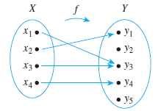
Definition of Function
Definition
A function f from a set X to a set Y, denoted f : X → Y, is a relation from X, the domain of f, to Y, the co-domain of f, that satisfies two properties: (1) every element in X is related to some element in Y, and (2) no element in X is related to more than one element in Y.
Thus, given any element x in X, there is a unique element in Y that is related to x by f.
The unique element to which f sends
x is denoted f (x) and is called f of x,
or the output of f for the input x,
or the value of f at x,
or the image of x under f.
The set of all values of f taken together is called the range of f or the image of X under f.

Slide 7
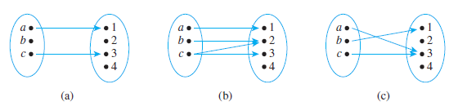
Functions and Non functions
Define functions from X = {a, b, c} to Y ={1, 2, 3, 4}
(a). It is not a function because there is an element of X, namely b, that is not sent to any element of F; that is, there is no arrow coming out of b
(b). It is not a function because the element c is not sent to a unique element of Y; that is, there are two arrows coming out of c, one pointing to 2 and the other to 3.
(c). It is a function.

Slide 8
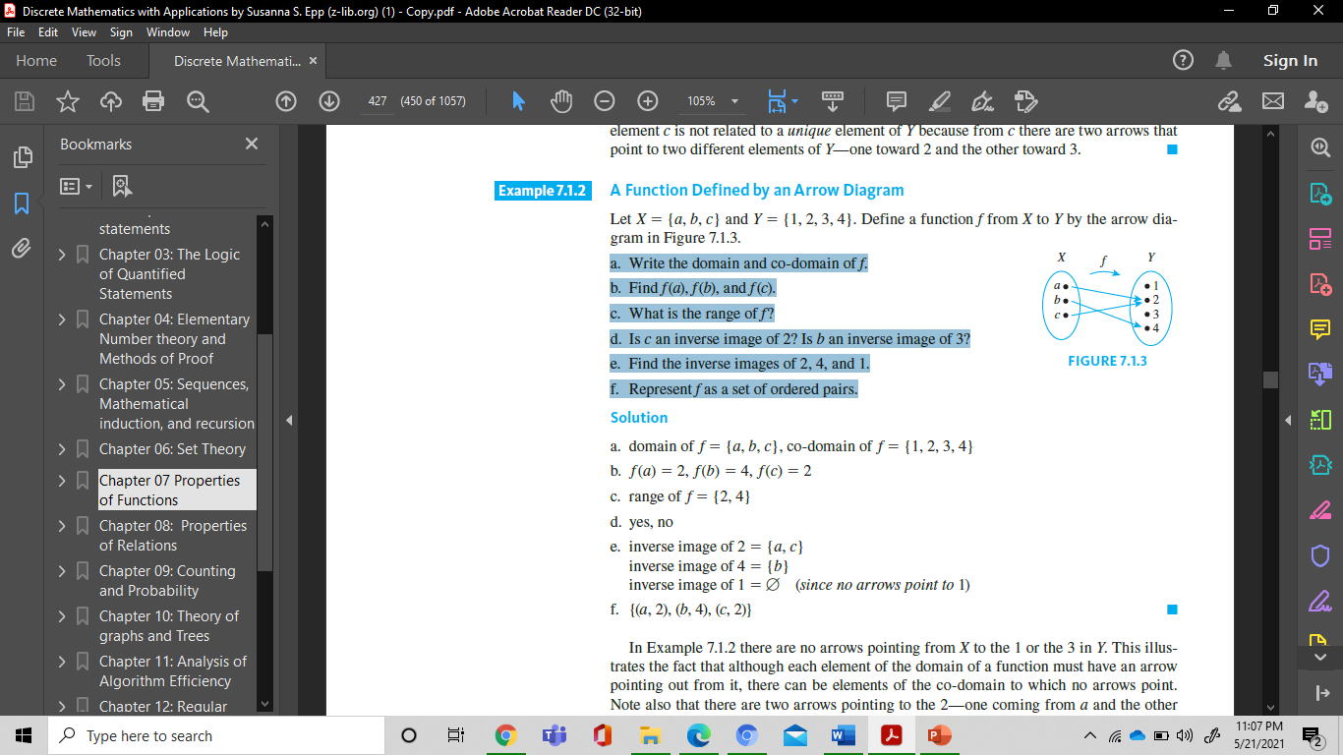
A Function Defined by an Arrow Diagram (1)
Example :
Let X = {a, b, c} and Y = {1, 2, 3, 4}. Define a function f from X to Y by the arrow diagram in Figure below :
a. Write the domain and co-domain of f.
b. Find f (a), f (b), and f (c).
c. What is the range of f?
d. Is c an inverse image of 2?
Is b an inverse image of 3?
e. Find the inverse images of 2, 4, and 1.
f. Represent f as a set of ordered pairs.

Slide 9
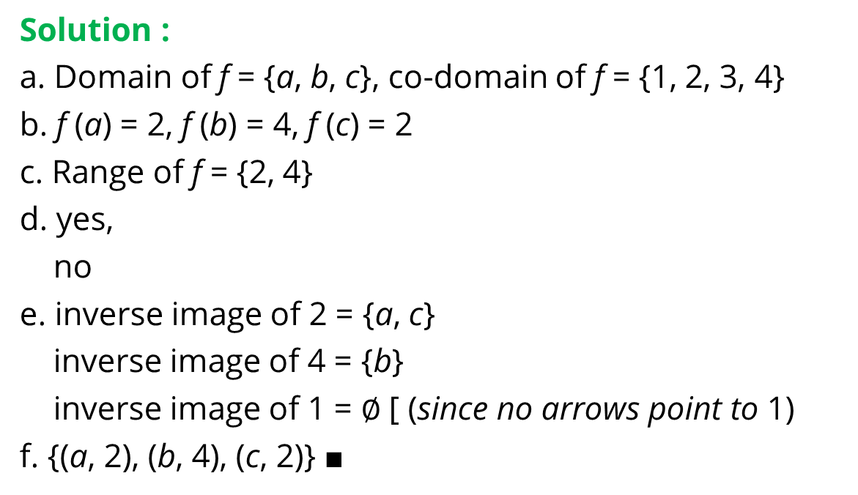
A Function Defined by an Arrow Diagram (2)
Solution :
a. Domain of f = {a, b, c}, co-domain of f = {1, 2, 3, 4}
b. f (a) = 2, f (b) = 4, f (c) = 2
c. Range of f = {2, 4}
d. yes,
no
e. inverse image of 2 = {a, c}
inverse image of 4 = {b}
inverse image of 1 = $∅$ [ (since no arrows point to 1)
f. {(a, 2), (b, 4), (c, 2)} ■

Slide 10
One-to-one, Onto, And Inverse Functions
Don’t Accept A Statement Just Because It Is Printed. —Anna Pell Wheeler, 1883–1966

Slide 11
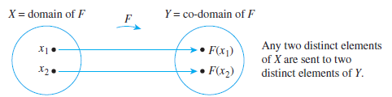
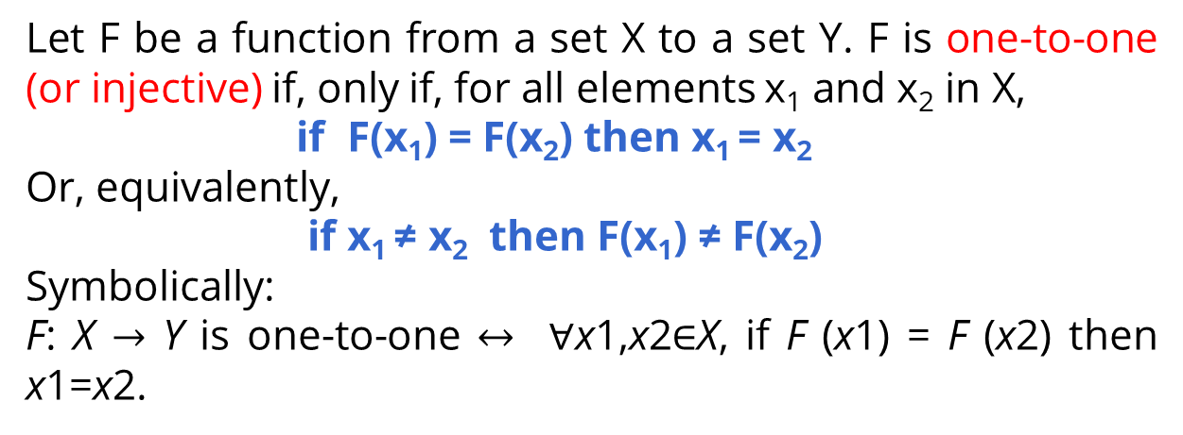
One-to-One Functions
Definition
Let F be a function from a set X to a set Y. F is one-to-one (or injective) if, only if, for all elements x₁ and x₂ in X,
if F(x₁) = F(x₂) then x₁ = x₂
Or, equivalently,
if x₁ ≠ x₂ then F(x₁) ≠ F(x₂)
Symbolically:
F: X $→$ Y is one-to-one $↔$ $∀$x1,x2$∈$X, if F (x1) = F (x2) then x1=x2.

Slide 12
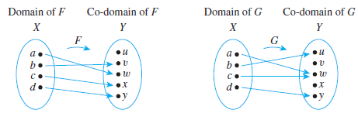
Identifying One-to-One Functions
Defined on Finite Sets
F is one-to-one but G is not.
F is one-to-one because no two different elements of X are sent by F to the same element of Y.
G is not one-to-one because the elements a and c are both sent by G to the same element of Y: G(a) = G(c) = w but a ≠ c.

Slide 13
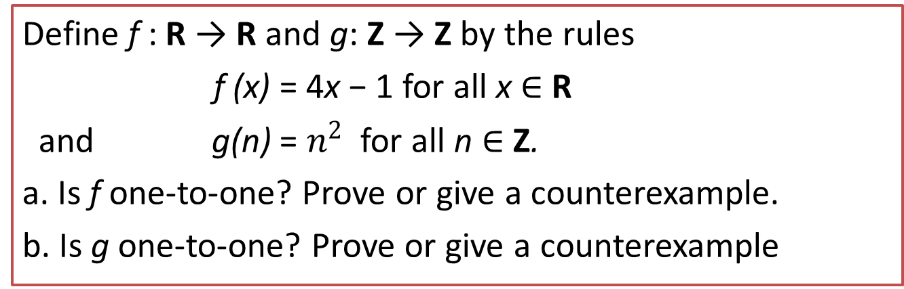
Proving or Disproving That Functions Are One-to-One
One-to-One Functions on
Infinite Sets
Example :

Slide 14
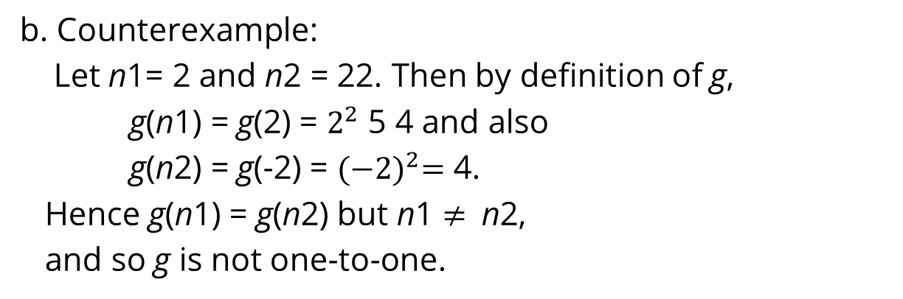
Proving or Disproving That Functions Are One-to-One
Solution :
a. Suppose x1 and x2 are real numbers such that
f (x1) = f (x2).
4x1 − 1 = 4x2 − 1.
4x1 = 4x2,
x1 = x2,
which is what was to be shown that f is one-to-one
b. Counterexample:
Let n1= 2 and n2 = 22. Then by definition of g,
g(n1) = g(2) = $2^{2}$ 5 4 and also
g(n2) = g(-2) = ${(−2)}^{2}=$ 4.
Hence g(n1) = g(n2) but n1 $≠$ n2,
and so g is not one-to-one.

Slide 15
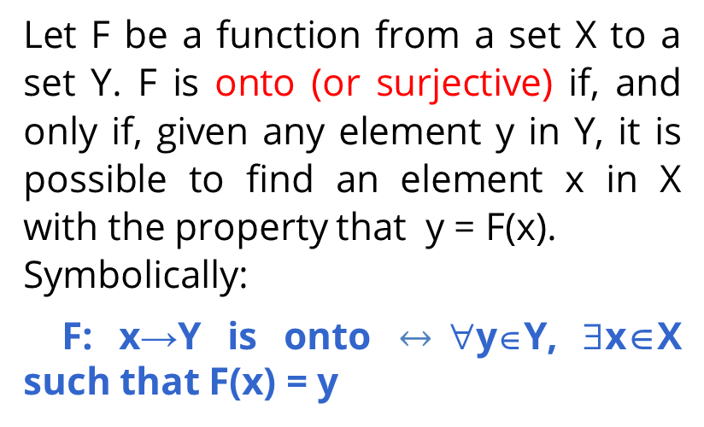

Onto Functions
Definition
Let F be a function from a set X to a set Y. F is onto (or surjective) if, and only if, given any element y in Y, it is possible to find an element x in X with the property that y = F(x).
Symbolically:
F: x→Y is onto $↔$∀y∈Y, ∃x∈X such that F(x) = y

Slide 16
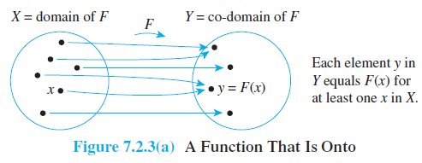
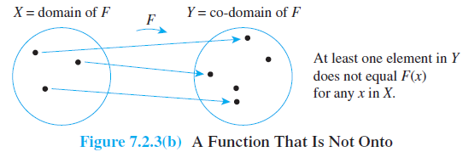
Illustrations
A Function That is Onto
A Function That is Not Onto

Slide 17
Onto Function on infinite series
Example :
Define f : R → R and h: Z → Z by the rules
f (x) = 4x − 1 for all x ∈ R
and
h(n) = 4n − 1 for all n ∈ Z.
a. Is f onto? Prove or give a counterexample.
b. Is h onto? Prove or give a counterexample

Slide 18
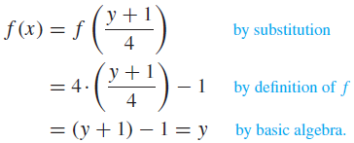
Proving or Disproving That Functions Are Onto(1)
Solution :
a. Let y ∈ R. [We must show that ∃x in R such that f(x)= y.] Let x = (y + 1)/4. Then x is a real number since sums and quotients (other than by 0) of real numbers are real numbers. It follows that
[This is what was to be shown, so that f is onto]

Slide 19

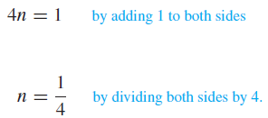
Proving or Disproving That Functions Are Onto(2)
b. Counterexample:
The co-domain of h is Z and 0 ∈ Z. But h(n) ≠ 0 for any integer n. For if h(n) = 0, then
which implies that
And so
But 1/4 is not an integer. Hence there is no integer n for which h (n) = 0, and thus h is not onto.

Slide 20
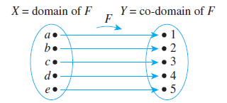
One-to-One Correspondences
Definition
A one-to-one correspondence (or bijection) from a set X to a set Y is a function
F: X → Y that is both one-to-one and onto.

Slide 21
One-to-One Correspondences (1)
Example :
Define a function F : R x R → R x R as follows:
For every (x, y) ∈ R x R, F(x, y) = (x+y, x-y).
Is F a one-to-one correspondence from R x R to itself?
Solution :
Proof that F is one-to-one:
Suppose that (x1, y1) and (x2, y2) are any ordered pairs in R x R such that F(x1, y1) = F(x2, y2).
[We must show that (x1, y1) = (x2, y2).] By definition of F,
(x1+y1, x1-y1) = (x2+y2, x2-y2).
For two ordered pairs to be equal, both the first and second components must be equal.
Thus x1, y1, x2, and y2 satisfy the following system of equations:
x1+y1 = x2+y2 (1)
x1+y1 = x2+y2. (2)

Slide 22
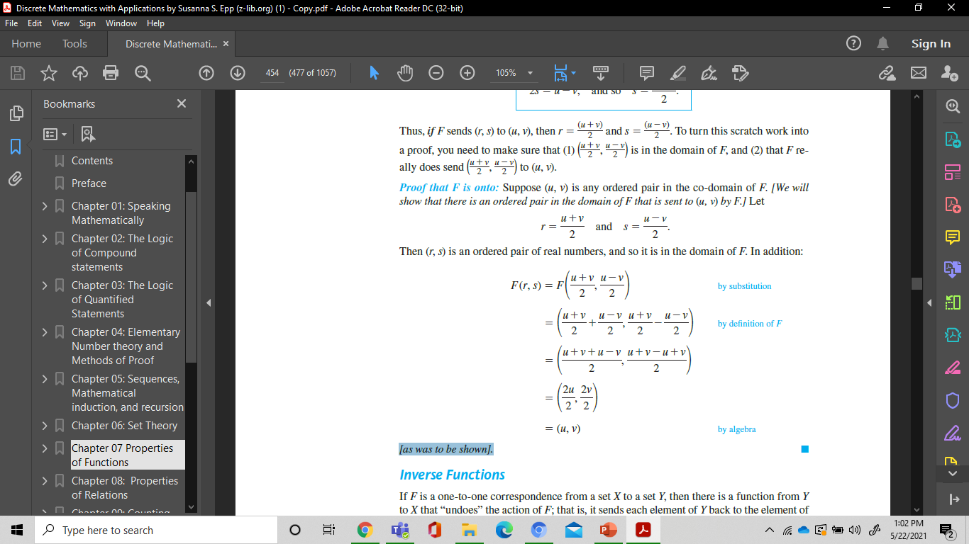
One-to-One Correspondences(2)
Solution :
Adding equations (1) and (2) gives that
2x1 = 2x2, and so x1 = x2.
Substituting x1 = x2 into equation (1) yields
x1+y1 = x1+y2, and so y1 = y2.
Thus, by definition of equality of ordered pairs, (x1, y1) = (x2, y2) [as was to be shown].
Proof that F is onto :
Suppose (u, v) is any ordered pair in the co-domain of F.
[We will show that there is an ordered pair in the domain of F that is sent to (u, v) by F.] Let

Slide 23
One-to-One Correspondences(3)
Then (r, s) is an ordered pair of real numbers, and so it is in the domain of F. In addition:
[as was to be shown].

Slide 24
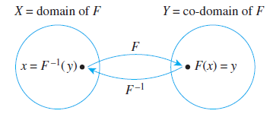
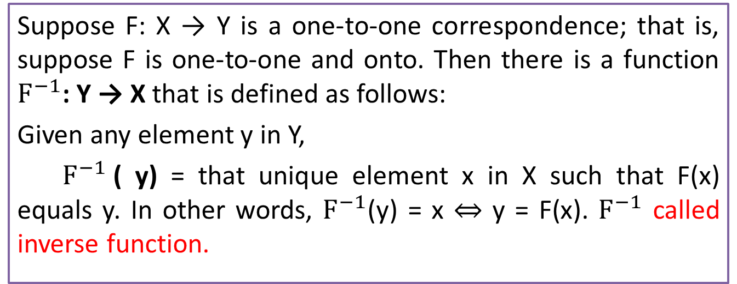
Inverse Functions
Theorem

Slide 25
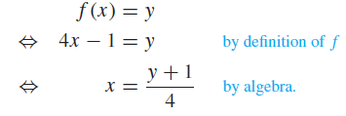

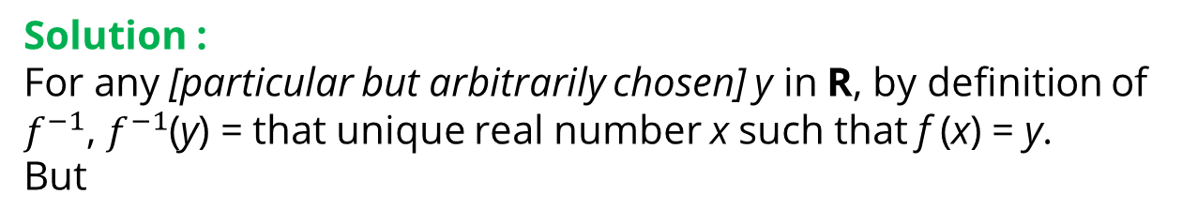
Finding an Inverse Function
Example :
The function f : R → R defined by the formula f (x) = 4x − 1 for all real numbers x. Find its inverse function.
Solution :
For any [particular but arbitrarily chosen] y in R, by definition of $f^{−1}$, $f^{−1}$(y) = that unique real number x such that f (x) = y.
But
Hence

Slide 26
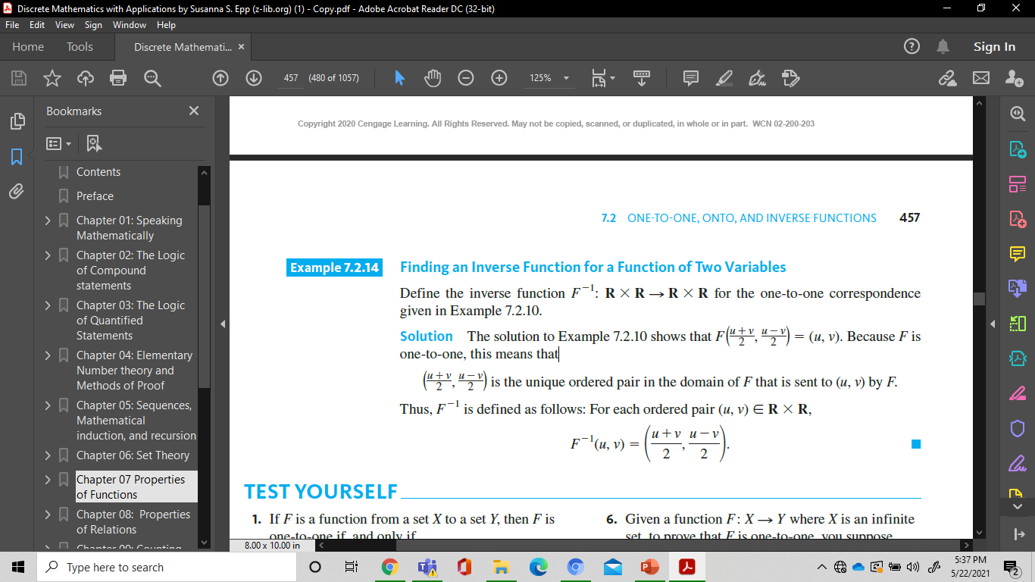
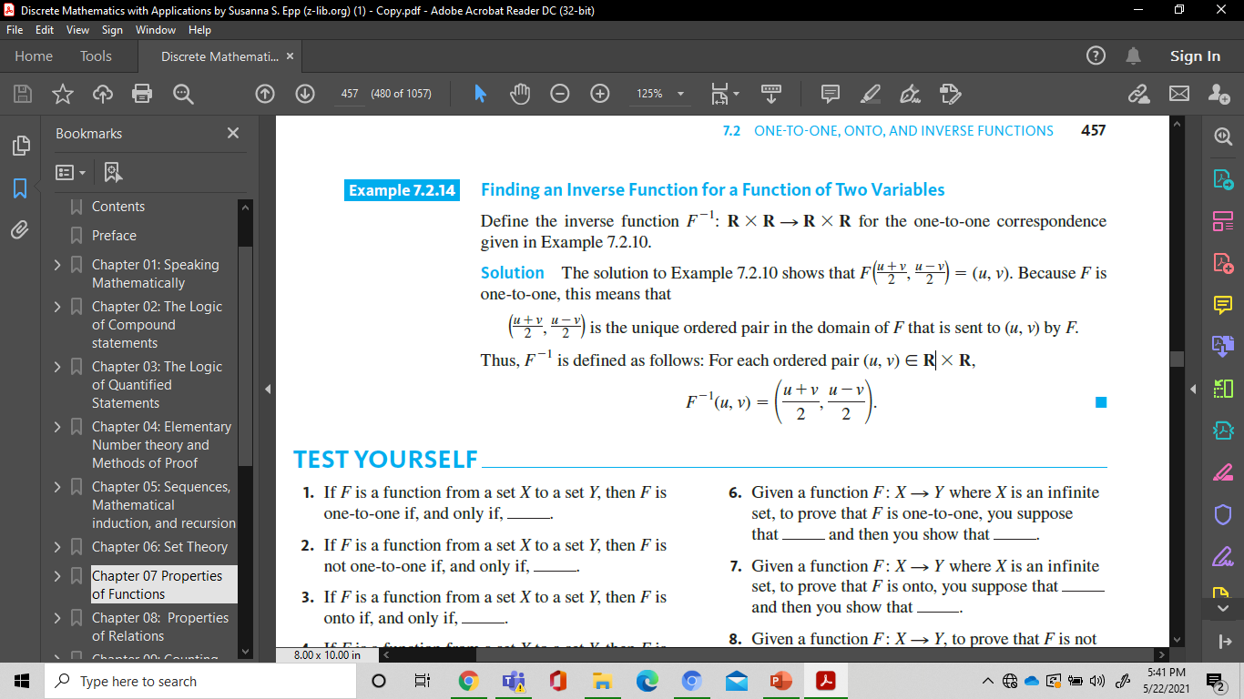
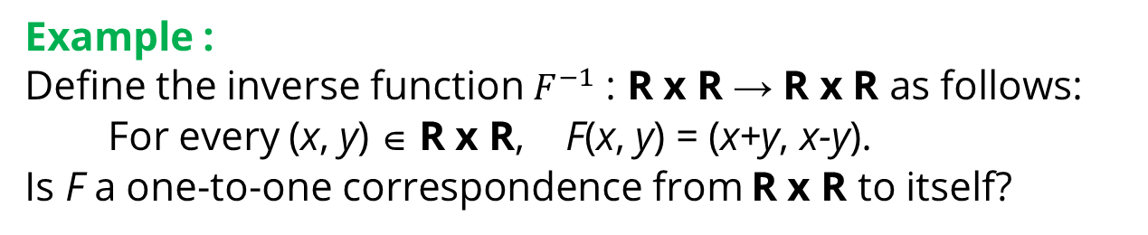
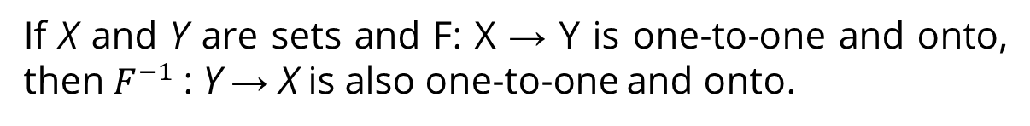
Inverse Functions (2)
Theorem
If X and Y are sets and F: X → Y is one-to-one and onto, then $F^{−1}$: Y → X is also one-to-one and onto.
Example :
Define the inverse function $F^{−1}$ : R x R → R x R as follows:
For every (x, y) ∈ R x R, F(x, y) = (x+y, x-y).
Is F a one-to-one correspondence from R x R to itself?
Solution :
Because F is one-to-one, this means that
is the unique ordered pair in the domain of F that is sent to (u, v) by F.
Thus, $F^{−1}$ is defined as follows: For each ordered pair (u, v)∈ RxR,

Slide 27
Composition Of Functions
It Is No Paradox To Say That In Our Most Theoretical Moods We May Be Nearest To OurMost Practical Applications.
—Alfred North Whitehead

Slide 28
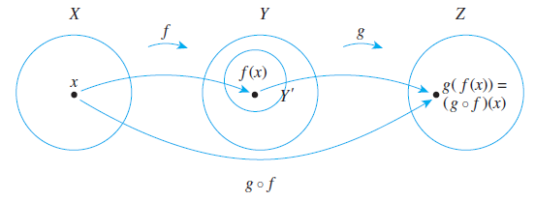
Definition
Composition of Functions
Let f : X → Y and g: Y’ → Z be functions with the property that the range of f is a subset of the domain of g. Define a new function g ◦ f : X → Z as follows:
(g ◦ f )(x) = g( f (x)) for all x ∈ X,
where g ◦ f is read “g circle f ” and g( f (x)) is read “g of f of x.” The function g ◦ f is called the composition of f and g.

Slide 29
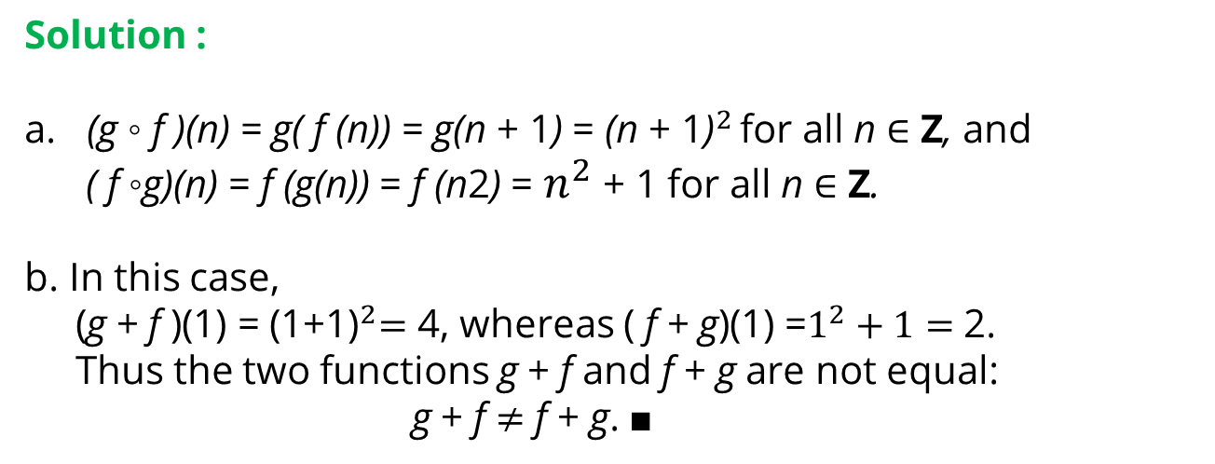
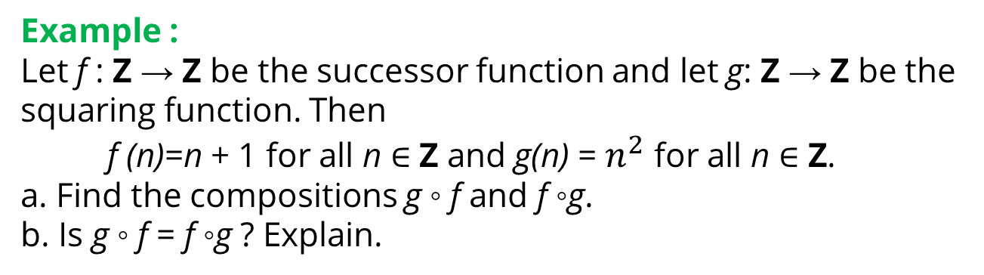
Composition of Functions
Defined by Formulas
Example :
Let f : Z → Z be the successor function and let g: Z → Z be the squaring function. Then
f (n)=n + 1 for all n ∈ Z and g(n) = $n^{2}$ for all n ∈ Z.
a. Find the compositions g ◦ f and f ◦g.
b. Is g ◦ f = f ◦g ? Explain.
Solution :
a. (g ◦ f )(n) = g( f (n)) = g(n + 1) = ${\text{(}\text{n} \text{+ 1}\text{)}}^{2 }$for all n ∈ Z, and
( f ◦g)(n) = f (g(n)) = f (n2) = $n^{2}$ + 1 for all n ∈ Z.
b. In this case,
(g + f )(1) = ${\text{(1+1)}}^{2}=$ 4, whereas ( f + g)(1) =$1^{2}+1=$2.
Thus the two functions g + f and f + g are not equal:
g + f $≠$ f + g. ■

Slide 30
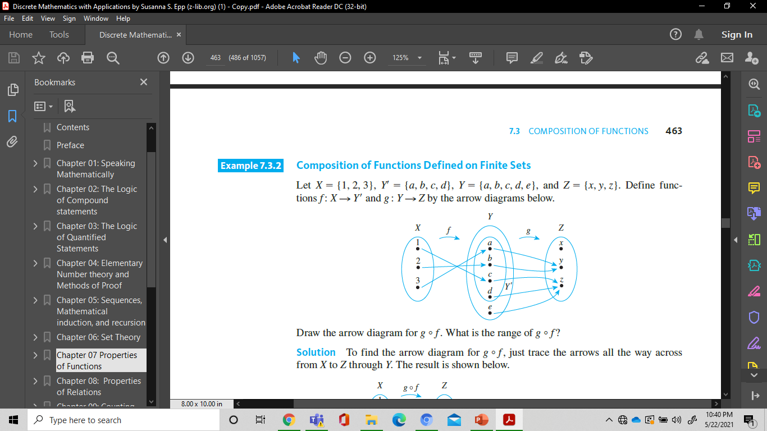
Composition of Functions
Defined on Finite Sets
Example :
Let X = {1, 2, 3}, Y’= {a, b, c, d}, Y = {a, b, c, d, e}, and Z = {x, y, z}. Define functions
f : X → Y’ and g : Y → Z by the arrow diagrams below.
Draw the arrow diagram for g + f . What is the range of g + f ?

Slide 31
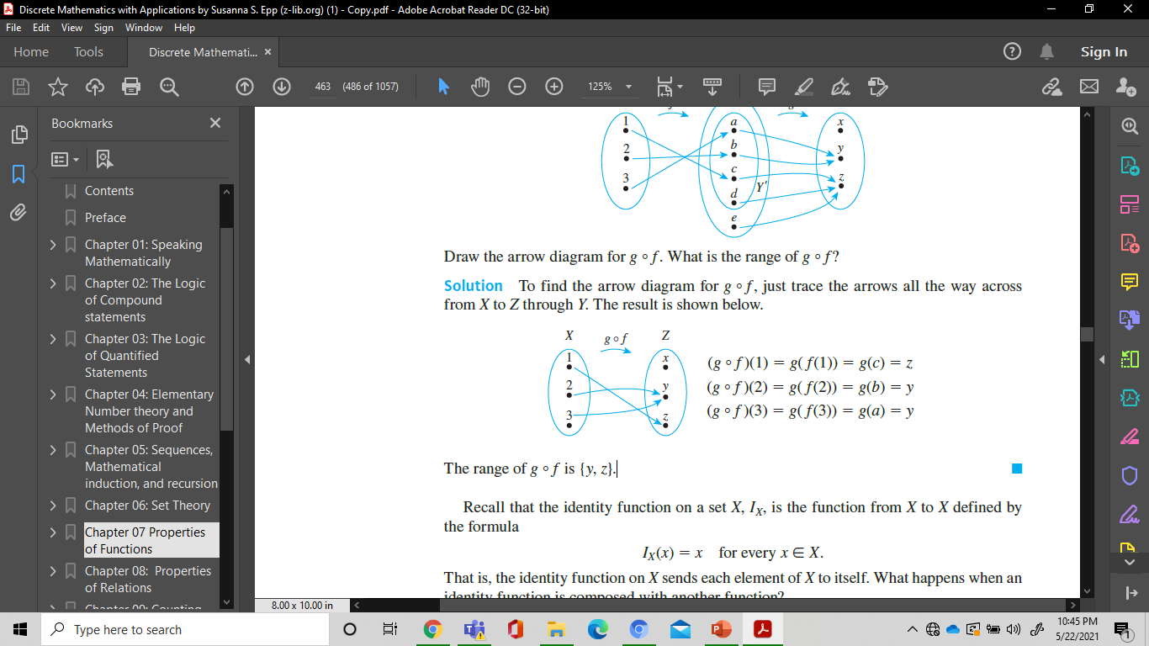
Composition of Functions
Defined on Finite Sets
Solution :
The range of g + f is {y, z}.

Slide 32
Definition Of Fuzzy Set

Slide 33
Fuzzy Set
Fuzzy Set Theory was formalized by Professor Lofti Zadeh at the University of California in 1965. What Zadeh proposed is very much a paradigm shift that first gained acceptance in the Far East and its successful application has ensured its adoption around the world.

Slide 34
Fuzzy Sets
Formal definition:
A fuzzy set A in X is expressed as a set of ordered pairs:
Crisp set A
Fuzzy set A
1.0
1.0
.9
.5
5’10’’
Heights
5’10’’
6’2’’
Heights
Notes:
A fuzzy set is a set with fuzzy boundary. Suppose that A is the set of tall people. In a conventional set, or crisp set, an element is either belong to not belong to a set; there nothing in between. Therefore to define a crisp set A, we need to find a number, say, 5??, such that for a person taller than this number, he or she is in the set of tall people. For a fuzzy version of set A, we allow the degree of belonging to vary between 0 and 1. Therefore for a person with height 5??, we can say that he or she is tall to the degree of 0.5. And for a 6-foot-high person, he or she is tall to the degree of .9. So everything is a matter of degree in fuzzy sets. If we plot the degree of belonging w.r.t. heights, the curve is called a membership function. Because of its smooth transition, a fuzzy set is a better representation of our mental model of all? Moreover, if a fuzzy set has a step-function-like membership function, it reduces to the common crisp set.

Slide 35
Alternative Notation
A fuzzy set A can be alternatively denoted as follows:
X is discrete
X is continuous
Note that S and integral signs stand for the union of membership grades; “/” stands for a marker and does not imply division.

Slide 36
Properties of Fuzzy Set

Slide 37
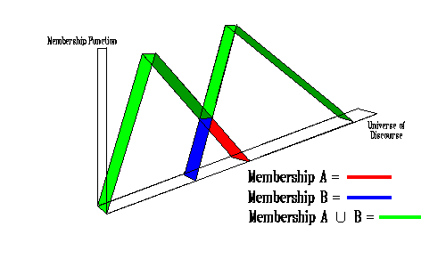
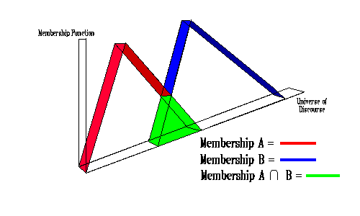
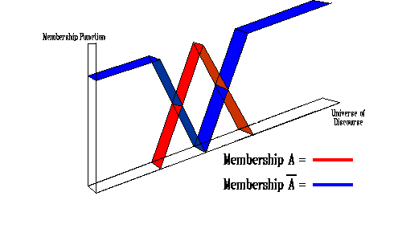
Operations of Fuzzy Set (1/2)
Union :
μ_{A∪B}(x) = max(μ_{A}(x),μ_{B}(x))
Intersection:
μ_{A∩B}(x) = min(μ_{A}(x),μ_{B}(x))
Complement:
μ_{not A}(x) = 1-μ_{A}(x))

Slide 38
Operations of Fuzzy Set (2/2)
Fuzzy set A is equal to fuzzy set B if
Fuzzy set A is subset of fuzzy set B

Slide 39

Support
The support of a fuzzy set A in the universe of discourse U is a crisp set that contains all the elements of U that have nonzero membership values in A
If the support of a fuzzy set is empty it is called and empty fuzzy set

Slide 40

Alpha - Cut
An α-cut of a fuzzy set A is a crisp set Aα that contains all the elements in U that have membership values in A greater than or equal to α

Slide 41
Cardinality
A fuzzy set A in X has cardinality

Slide 42
Example: Discrete
Fuzzy Set (1/2)
(usia)
x
(x)
(x)
(x)
(x)
5
0
0
1
0
10
0
0
1
0
20
0
0,8
0,8
0,1
30
0
1
0,5
0,2
40
0
1
0,2
0,4
50
0
1
0,1
0,6
60
0
1
0
0,8
70
0
1
0
1
80
0
1
0
1

Slide 43
Example: Discrete
Fuzzy Set (2/2)
supp Tua = {20,30,40,50,60,70,80}
Muda _{0,2} = {5,10,20,30,40}
Muda _{0,8} = {5,10,20}
Muda₁ = {5,10}
|Bayi| = 0
Muda U Tua = 1/5+1/10+0,8/20+0,5/30+0,4/40
+0,6/50+0,8/60+1/70+1/80.
Muda ∩ Tua = 0,1/20+0,2/30+0,2/40+0,1/50

Slide 44
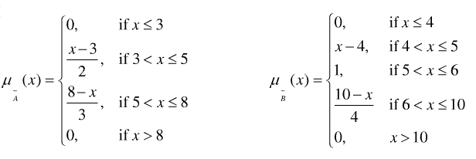
Example: Continuous
Fuzzy Set (1/4)
Giving two fuzzy utilities expressed in
Draw their figures
Draw A∩B, A∪B, A^{c}, B^{c}, A^{c}∪B^{c},A^{c}∩B^{c} and support of them

Slide 45
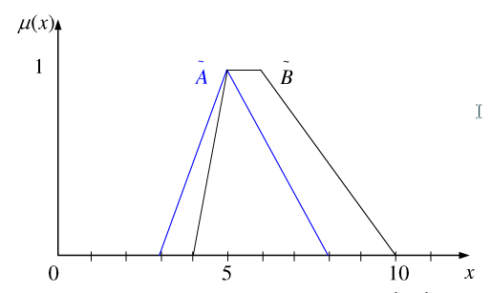
Example: Continuous
Fuzzy Set (2/4)
Supp (A∩B) = 4 < x < 8
A∩B
Supp (A) = 3 < x < 8
Supp (B) = 4 < x < 10

Slide 46
Example: Continuous
Fuzzy Set (3/4)
Supp (A∪B) = 3 < x < 10
A^{c}
B^{c}
A∪B
Supp (A^{c}) = x ≠ 5
Supp (B^{c}) = x < 5, x > 6

Slide 47
Example: Continuous
Fuzzy Set (4/4)
Supp (A^{c}∪B^{c}) = x ≠ 5
1
A^{c}∩B^{c}
A^{c}
B^{c}
1
A^{c}∪B^{c}
0
5
10
A^{c}
B^{c}
Supp (A^{c}∩B^{c}) = x < 5, x > 6
0
5
10

Slide 48
References
Susanna S.Epp, “ Discrete Mathematics with Applications”, 5th edition,2020, Cengage, Boston, USA, ISBN 9781337694193
Kenneth H. Rosen, “ Discrete Mathematics and its Applications”, 8th edition,2019, McGraw-Hill Education, New York, ISBN 978-1-259-67651-2

Slide 49
THANK YOU

